Slide 1

Deep Learning for Time Dependent Tasks and Time Independent Tasks
Chang Xu
http://Chang-xu.github.io
Notes:
Hello the Fellowship Selection Committee, My name is Chang Xu. I am a second-year Ph.D. candidate.
I would like to introduce some of my research projects about Knowledge powered deep learning
and Sequential deep learning.

Slide 2


Who am I
Joint PhD candidate, Nankai University, MSRA. Advised by Prof. Tie-Yan Liu and Prof. Gang Wang.
Research Interests: Machine Learning, Representation Learning, Reinforcement Learning
Publications
Chang Xu, Gang Wang, Xiaoguang Liu, Dongdong Guo and Tie-Yan Liu, Health Status Assessment and Failure Prediction for Hard Drives with Recurrent Neural Networks, IEEE Transactions on Computers, 2016.
Chang Xu, Yalong Bai, Jiang Bian, Bin Gao, Gang Wang, Xiaoguang Liu and Tie-Yan Liu, RC-NET: A General Approach to Incorporate Knowledge into Word Representations, CIKM, 2014.
Yuyu Zhang, Hanjun Dai, Chang Xu, Jun Feng, Taifeng Wang, Jiang Bian, Bin Wang and Tie-Yan Liu, Sequential Click Prediction for Sponsored Search with Recurrent Neural Networks, AAAI, 2014.
Yalong Bai, Kuiyuan Yang, Wei Yu, Chang Xu, Wei-Ying Ma and Tiejun Zhao, Automatic Image Dataset Construction from Click-through Logs Using Deep Neural Network, ACM MM, 2015.
Yalong Bai, Wei Yu, Tianjun Xiao, Chang Xu, Kuiyuan Yang, Wei-Ying Ma and Tiejun Zhao, Bag-of-words based deep neural network for image retrieval, ACM MM, 2014.
Fei Tian, Siyu Qiu, Chang Xu, Tie-Yan Liu, Word Embedding: Novel Representations for Natural Language in Continues Space, Journal of Data Acquisition & Processing, 2014 (In Chinese)
Selected Honors
First Place in MSR-Bing Image Retrieval Challenge at ACM Multimedia, 2014
The Google Anita Borg Memorial Scholarship: Asia Pacific, 2013
Notes:
Firstly, let me introduce myself.
I am a joint Ph.D. student of Microsoft Research Asia and Nankai University. My Ph.D. advisor is Professor Tie-Yan Liu and Professor Gang Wang.
My research interests are in the areas of deep learning, representation learning and reinforcement learning.
Here are some of my publications and honors.

Slide 3
Content
Previous Research Projects
Knowledge powered deep learning
Incorporating Knowledge into Word Representations
Sequential deep learning
Health Status Assessment for Hard Drives
Sequential Click Prediction for Sponsored Search
On-going Project
Deep Neural Network for Posed and Spontaneous Expression Recognition
Future Project
Deep Reinforcement Learning
Notes:
I am going to introduce my research projects in two directions.
One is Knowledge powered deep learning. A related project I worked on is incorporating Knowledge into Word Representations.
The other is sequential deep learning, including Health Status Assessment for Hard Drives and Sequential Click Prediction for Sponsored Search

Slide 4
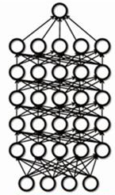
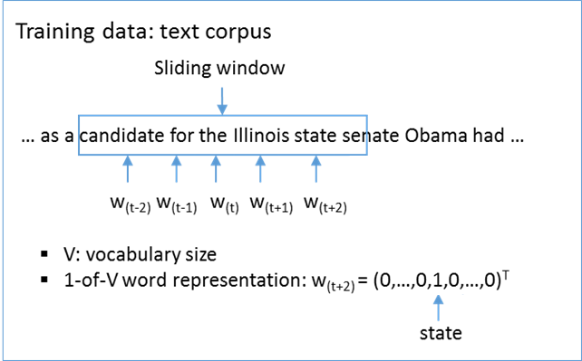
Word Embedding
Native Discrete Representation
Representations in Continuous Space
Word: 1-of-v vector
OS
$${\{w}_{1}, { w}_{2}, …, w_{i}, …, { w}_{V−1},{ w}_{V}\}$$
Deep Learning
$$\left\langle 0, 0, …, 1, …, 0, 0\right\rangle$$
Learning
Search
Mining
Retrieval
Natural Languages
State-of-the-art machine learning methods require data to be in a continuous space
Continuous representation eases text understanding, inference, and reasoning
Embedding
Notes:
Before presenting the method that proposed to Incorporate Knowledge into Word Representations, I would like to brief some background knowledge about distributed word representations.
As we all know, the native representation of words is in discrete forms, specifically 1-of-v vector, whose vocabulary is all the words and there is only one non-zero entry in the vector of each word.
Considering that many machine learning and data mining algorithms assume the data to be in a continuous space, in order to ease the understanding, learning, inference, and reasoning on text data, it is preferred to have a way to embed the discrete words into a continuous space. Recently, deep learning has been used to fulfill this task and achieved great success.

Slide 5
Challenges in Word Embedding
Word Representations learned from corpus
Based on the word co-occurrence information
Hard to reflect the inherent relationship between words
Noise and bias in free text
Word2Vec learns word representations from free texts in an unsupervised manner. However, free text data might be biased and noisy, thus not fully consistent with human knowledge.
Notes:
Although word embedding has been applied to many NLP tasks, it still suffers from some limitations.
In particular, previous works learned word representations mainly based on the word co-occurrence information. If either of two syntactically or semantically similar words yields very little context information, the relationship between these two words cannot be captured by the obtained word embeddings.
On the other hand, even enough amount of context could be noisy or biased such that they cannot reflect the inherent relationship between words and further mislead the training process.

Slide 6
Knowledge Graph
A kind of knowledge base
Store complex structure and unstructured knowledge.
In form of a directed or undirected graph
What can Knowledge Graph provide for learning word representation
Mapping the vertices and edges in knowledge graph space into word representations space
More powerful word representations
Knowledge Graph
United Kingdom
Alias: United Kingdom, Great Britain, UK, U.K., GB, GBR, United Kingdom of Great Britain and Ireland, Britain
King_of
Queen_of
Wife_of
George VI
Gender: Male
Child_of
Elizabeth II
Gender: Female
Prince Philip, Duke of Edinburgh
Gender: Male
Child_of
Child_of
Diana, Princess of Wales
Gender: Female
Wife_of
Charles, Prince of Wales
Gender: Male
Notes:
To solve these problems, we propose to incorporate the information from knowledge graphs into the learning process in order to produce better word representations.
As we know, knowledge graph is a kind of knowledge base which has been widely used to store complex structure and unstructured knowledge. It is usually in the form of a directed or undirected graph, and the vertices and edges in the graph represents entities and relationships respectively, as shown in this figure.

Slide 7
Knowledge Categories in Knowledge Graph
Knowledge Graph
Relation Knowledge
Wife_of
<Elizabeth II, Prince Philip> <Diana, Charles>
King_of
<George VI, Britain>
United Kingdom
Alias: United Kingdom, Great Britain, UK, U.K., GB, GBR, United Kingdom of Great Britain and Ireland, Britain
Child_of
<Elizabeth II, George VI> <Charles, Elizabeth II> <Charles, Prince Philip>
Queen_of
<Elizabeth II, Britain>
King_of
Queen_of
Wife_of
George VI
Gender: Male
Child_of
Elizabeth II
Gender: Female
Prince Philip, Duke of Edinburgh
Gender: Male
Categorical Knowledge
Synonyms of U.K.
Britain, United Kingdom , Great Britain, UK, U.K., GB, GBR, United Kingdom of Great Britain and Ireland
Male
George VI, Prince Philip, Charles
Child_of
Child_of
Diana, Princess of Wales
Gender: Female
Wife_of
Charles, Prince of Wales
Gender: Male
Female
Elizabeth II, Diana
Notes:
A knowledge graph commonly contains two forms of knowledge: relational knowledge and categorical knowledge.
Specially, relational knowledge encodes the relationship between entities in knowledge graph. Like “capital-of”, “child-of” and so on.
And, categorical knowledge encodes the attributes and properties of entities in knowledge graph. Like “gender” and so on.
As shown in this figure, given a knowledge graph, we can split it into relation knowledge set and categorical knowledge set. We model these two different kinds of knowledge in different ways.

Slide 8
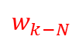
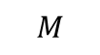
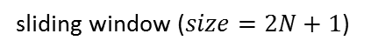
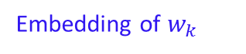

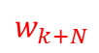
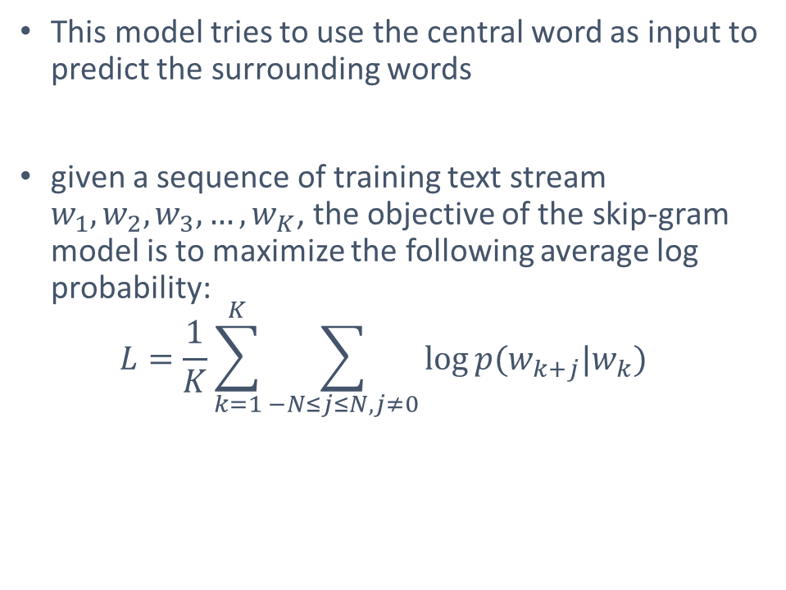
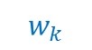
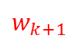

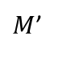
Learn from corpus: Skip-gram
This model tries to use the central word as input to predict the surrounding words
given a sequence of training text stream $w_{1},w_{2},w_{3},…, w_{K}$, the objective of the skip-gram model is to maximize the following average log probability:
$$L=\frac{1}{K}\sum_{k=1}^{K}{\sum_{−N≤j≤N, j≠0}{\log{p(w_{k+j}|w_{k})}}}$$
$$w_{k−N}$$
. . .
$$w_{k−1}$$
$$w_{k+1}$$
. . .
$$w_{k+N}$$
$$softmax$$
. . .
. . .
$M$’
Embedding of $w_{k}$
$$M$$
$$w_{k}$$
sliding window ($size=2N+1$)
$$w_{1},…,w_{k−N−1},w_{k−N},…,w_{k−1},w_{k},w_{k+1},…,w_{k+N},w_{k+N+1},…,w_{K}$$
Notes:
Here is the basic model called “skip-gram” which aims to learn word representations only from corpus. Our methods are proposed based on this model.
In the skip-gram model, as shown in this figure, a sliding window is employed on the input text stream to generate the training samples. In each sliding window, the model tries to use the central word as input to predict the surrounding words. The objective function of the skip-gram model is to maximize the log probability of its surrounding words given central word

Slide 9
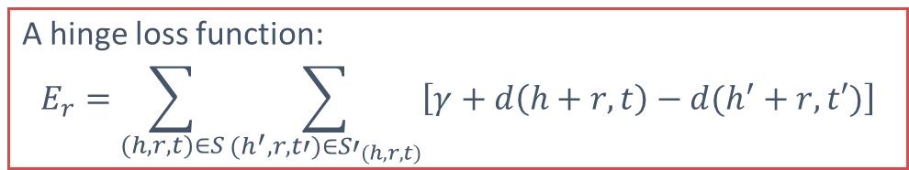
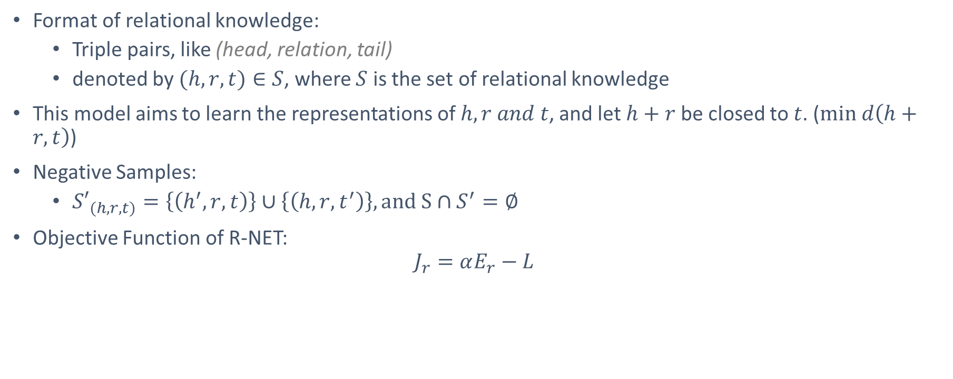
Learn from Relational knowledge: R-NET
Format of relational knowledge:
Triple pairs, like (head, relation, tail)
denoted by $(h,r,t)∈S$, where $S$ is the set of relational knowledge
This model aims to learn the representations of $h,r and t$, and let $h+r$ be closed to $t$. ($min d\left(h+r, t\right)$)
Negative Samples:
${S′}_{(h,r,t)}=\left\{\left(h^{′},r,t\right)\right\}∪\left\{\left(h,r,t^{′}\right)\right\}, and S∩S^{′}=∅$
Objective Function of R-NET:
$$J_{r}=αE_{r}−L$$
A hinge loss function:
$$E_{r}=\sum_{(h,r,t)∈S}{\sum_{(h^{′},r,t′)∈{S′}_{(h,r,t)}}{\left[γ+d\left(h+r, t\right)−d(h^{′}+r,t′)\right]}}$$
Skip-gram
Notes:
After briefing the skip-gram model, we introduce how we equip the basic model with the relational knowledge and categorical knowledge.
Firstly, I will introduce one of our models which can incorporate the relational knowledge into word representations.
The relational knowledge is usually represented in triplet, including head word, relationship and tail word. The motivation of the model is learning the representations of head word h, relationship r and tail word t, and let h plus r be closed to t. We get the objective function by combining the skip-gram objective function and the margin based regularization function derived from relational knowledge.

Slide 10

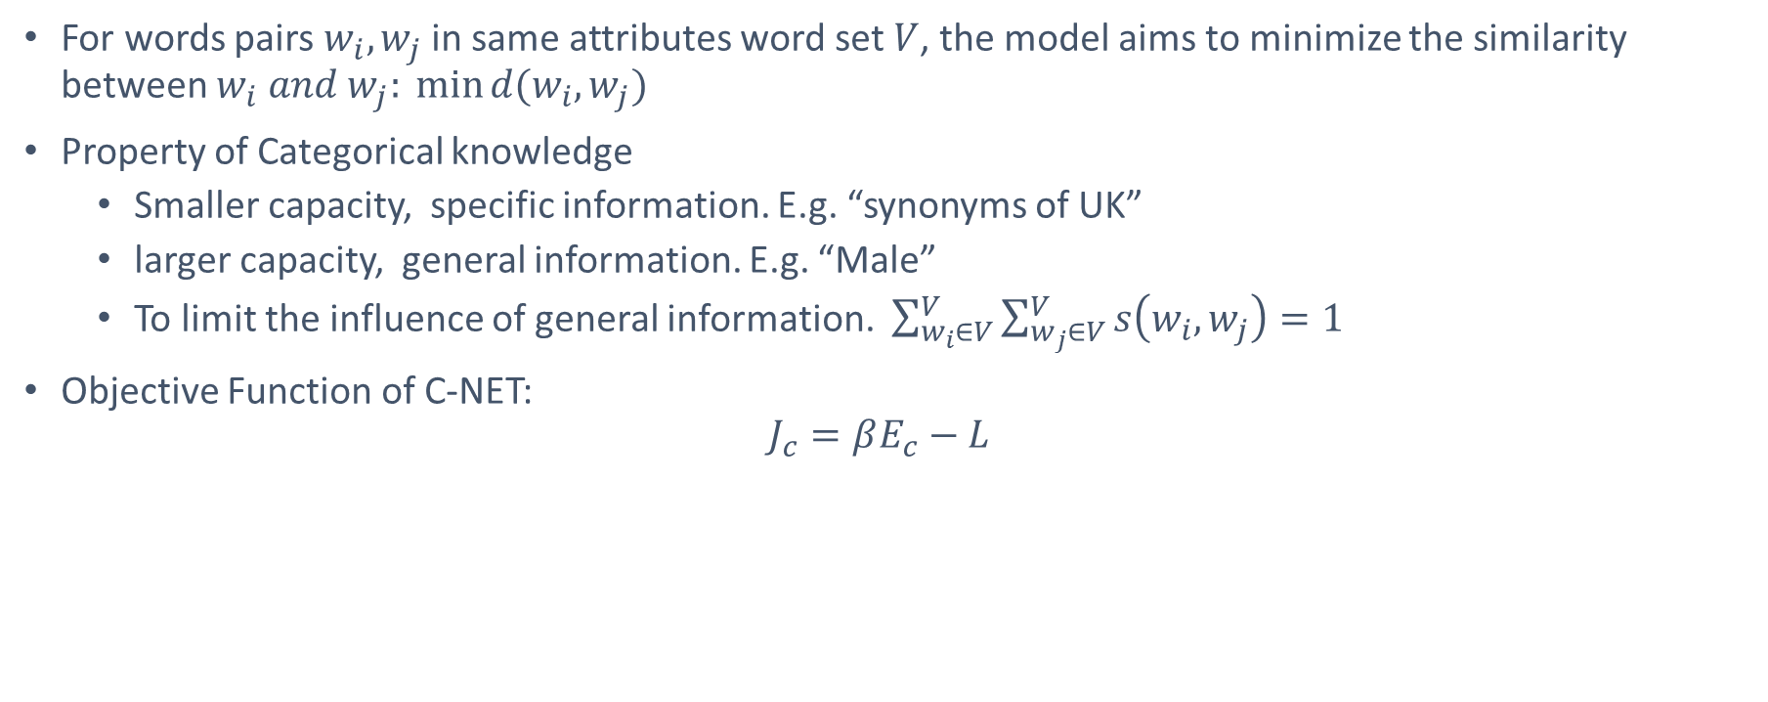
Learn from Categorical knowledge: C-NET
For words pairs $w_{i},w_{j}$ in same attributes word set $V$, the model aims to minimize the similarity between $w_{i} and w_{j}: \min{d(w_{i},w_{j})}$
Property of Categorical knowledge
Smaller capacity, specific information. E.g. “synonyms of UK”
larger capacity, general information. E.g. “Male”
To limit the influence of general information. $\sum_{w_{i}∈V}^{V}{\sum_{w_{j}∈V}^{V}{s\left(w_{i},w_{j}\right)}=1}$
Objective Function of C-NET:
$$J_{c}=βE_{c}−L$$
Skip-gram
$$E_{c}=\sum_{w_{i}∈V}^{V}{\sum_{w_{j}∈V}^{V}{s\left(w_{i},w_{j}\right)d(w_{i},w_{j})}}$$
Notes:
Here I will describe how we equip the skip-gram model with the categorical knowledge. Categorical knowledge encodes the attributes or properties of words, from which we can group similar words according to their attributes. Then we may require the representations of words that belong to the same category to be close to each other.
By combining the skip-gram objective function and the regularization function derived from the categorical knowledge, we get the objective function of C-NET.

Slide 11
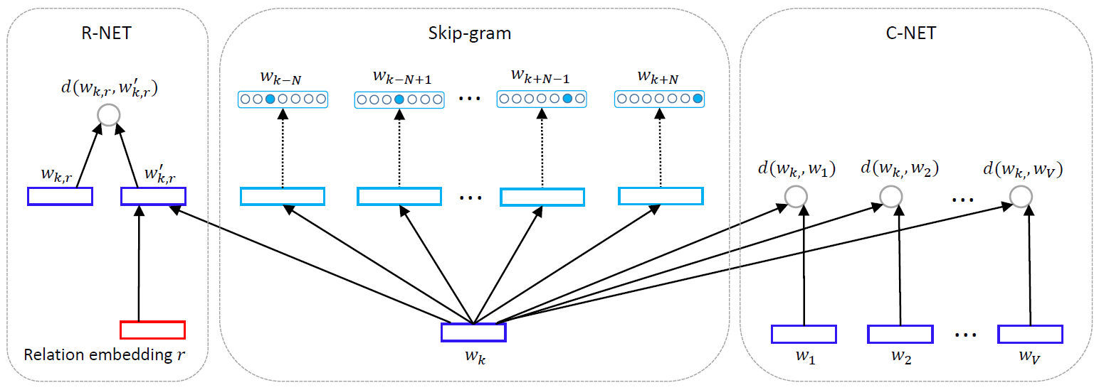
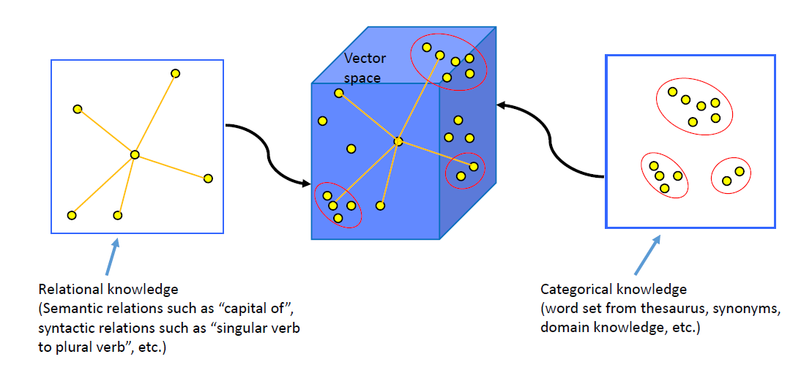
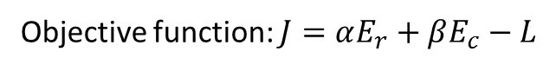
RC-NET
RC-NET
Objective function: $J=αE_{r}+βE_{c}−L$
Notes:
At last, we combine R-NET, C-NET and skip-gram into a global framework, which can leverage both relational and categorical knowledge to learn word representations, called RC-NET.
Actually with the RC-NET framework, the relational knowledge and categorical knowledge can compensate each other. On one hand, sometimes the relational knowledge of some words might be absent, but we can obtain their similar words from categorical knowledge and then make inference on their relations according to the relationships of their similar words. On the other hand, sometimes the categorical knowledge of a word might be missing. However, if the word share the same relationships with a number of other words, we will be able to infer its categorical knowledge from the categories of these related words.

Slide 12
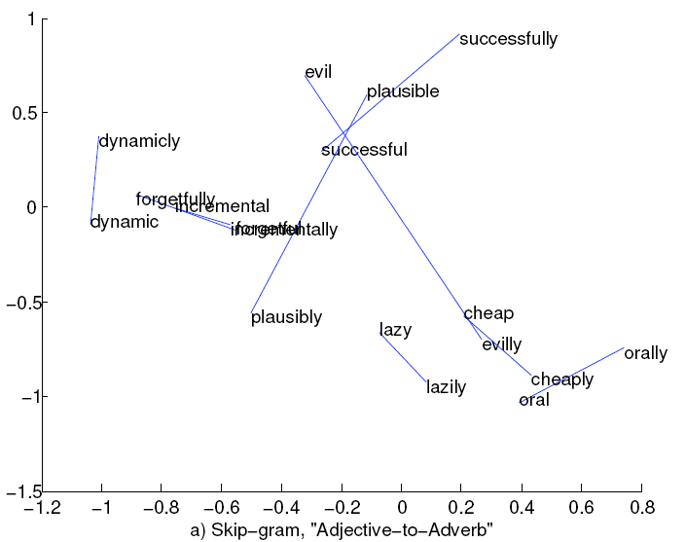
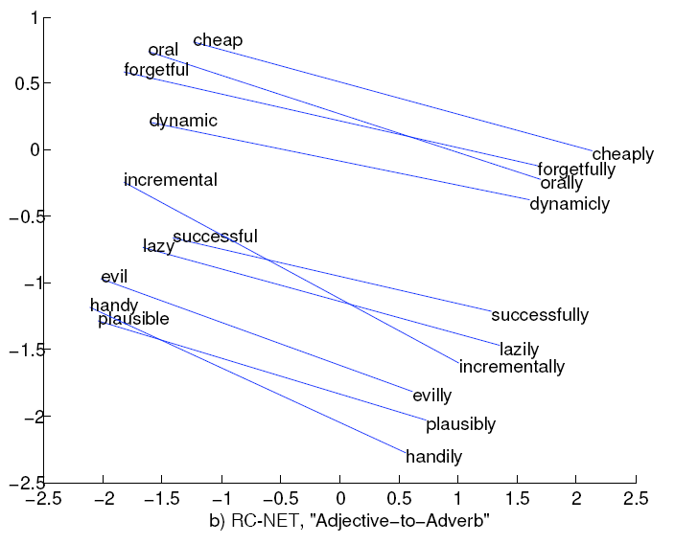
Word vector space influence by RC-NET
Notes:
We take case studies on a speciﬁc syntactic relationship called “Adjective to Adverb”. In particular, we apply the two-dimensional PCA projection on the 100-dimensional learned word embedding of randomly selected word pairs.
The left figure visualizes the word vector learned by skip-gram, and the right figure visualizes the word vector learned by RC-NET.
We can observe that RC-NET conduce the word pair in the same relationship tends to yield a common direction with similar distance, and those words corresponding to the same topic or domain tend to be close to each other.

Slide 13
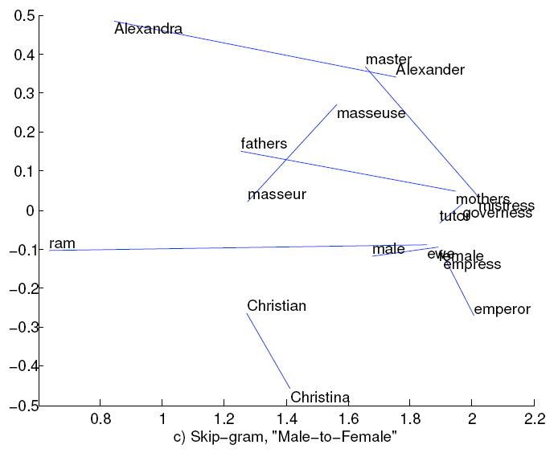
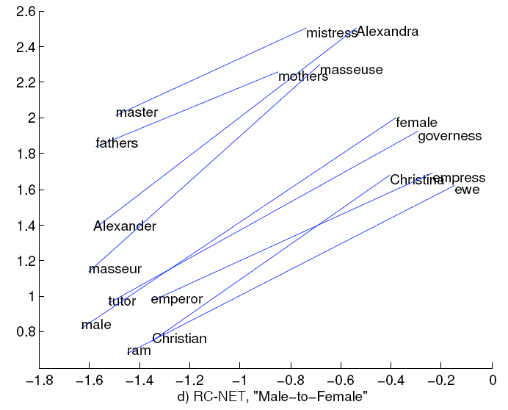
Word vector space influence by RC-NET
Notes:
We also conduct case studies on a speciﬁc semantic relationship called “Male to Female”.
From these figures, we can get similar observations.
We can see that our proposed RC-NET can signiﬁcantly improve the quality of word representations.

Slide 14
Content
Previous Research Projects
Knowledge powered deep learning
Incorporating Knowledge into Word Representations
Sequential deep learning
Health Status Assessment for Hard Drives
Sequential Click Prediction for Sponsored Search
On-going Project
Deep Neural Network for Posed and Spontaneous Expression Recognition
Future Project
Deep Reinforcement Learning
Notes:
Then I will introduce another one of my research topic, which is sequential deep learning.
I worked on two different research projects relevant to modeling sequential data.

Slide 15
Sequential Click Prediction for Sponsored Search
Sponsored search has been a major business model for modern commercial Web search engines.
Click prediction is one of the fundamental problems in sponsored search.
Importance of sequential modeling in sponsored search :
Most of existing studies predict ad click independently. However, user’s behaviors highly depend on how the user previously behaved along the time.
Faceted data analysis reveals sequential dependency between user’s ad impressions.
Notes:
The first time dependent task I worked on is sequential click prediction for sponsored search.
Click prediction is one of the fundamental problems in sponsored search.
Most of previous works ignore the sequential information and predict ad click independently. However, the sequential dependency can reflect user’s ad impressions. Thus, we proposed to employ sequential information to predict ad click.

Slide 16
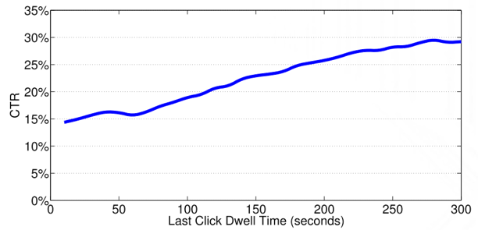
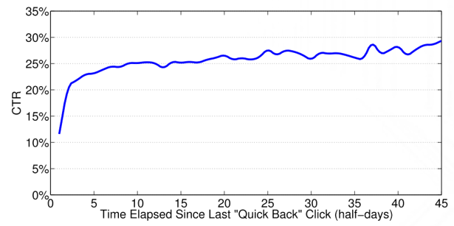
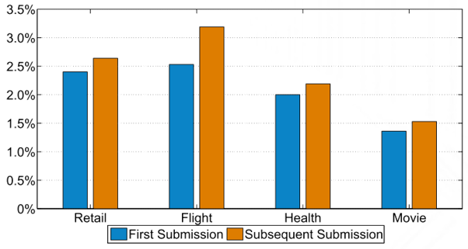
Data Analysis
User behavior is strongly and dynamically impacted by previous behavior.
There is obvious positive correlation between last click dwell time and current click-through rate.
Users tend to gradually forget the unhappy experience along with the time.
Once the user has submitted a query belonging to a certain query topic, he/she becomes more likely to click the ads under the same topic.
Notes:
Since the user behavior is strongly and dynamically impacted by previous behavior.
We can add features to describe the previous behavior to enhance the predicting model. However, sequential dependencies are hard to enumerate manually.
Thus, we employed RNN as our model to naturally embed dependencies in the sequence.

Slide 17
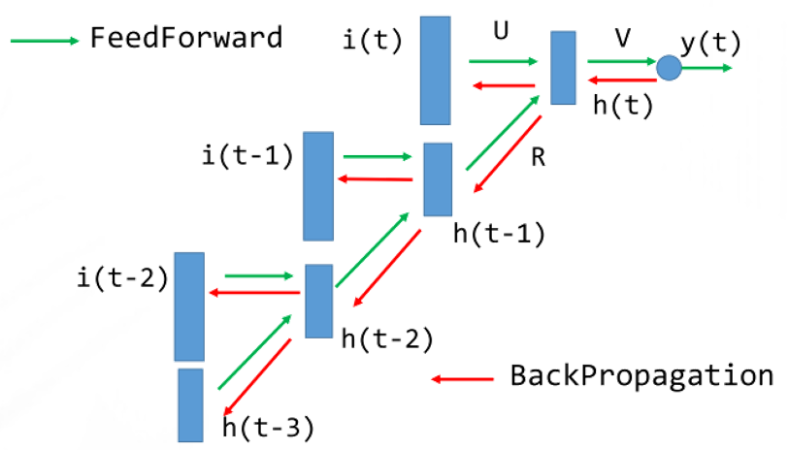
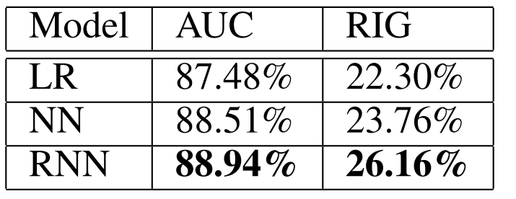
Model and Analysis
We compared Learning to Rank, Neural Network and Recurrent Neural Network for this task. RNN archived best performance.
In sponsored search, user’s behavior is affected by both the very recent events as explicit factor and the long-run history as background implicit factor.
Notes:
We compared the performance of Learning to Rank, Neural Network and Recurrent Neural Network on this task. As shown in the table, RNN outperforms other baseline methods.
In sponsored search, user’s behavior is affected by both the very recent events as explicit factor and the long-run history as background implicit factor. That’s why RNN works so well for the sequential click prediction.

Slide 18
Health Status Assessment for Hard Drives
Target on improving the reactive fault tolerance techniques in large scale storage systems
Log data of large scale storage systems:
SMART(Self-Monitoring, Analysis, and Reporting Technology) attributes -- logged with time stamps, in order to monitor internal attributes of individual hard drives and to raise alarms if any attribute exceeds its threshold.
Before a hard drive fails completely, there is a gradual trend towards abnormal status in SMART attributes. That is, there is a gradual process of deterioration in health status. Thus the SMART attributes can be regarded as time sequential data
Notes:
Health Status Assessment for Hard Drives is another time dependent task I worked on.
This task aims at improving the reactive fault tolerance techniques in large scale storage systems
As observed in real-world data centers, before a hard drive fails completely, there is a gradual trend towards abnormal status in SMART attributes. That is, there is a gradual process of deterioration in health status. Thus the SMART attributes can be regarded as time sequential data. Recurrent neural network is naturally suitable for this task.

Slide 19
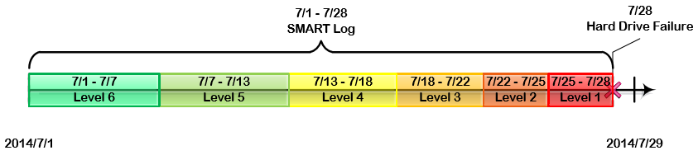
Health Degree
Most of these studies have focused on predicting failures of hard drives, i.e., labeling the status of a hard drive as “good” or not. However, in real-world storage systems, hard drives often deteriorate gradually rather than suddenly
We describe the health status of a hard drive by the length of time before it breaks down, and we deﬁne health degree by dividing the remaining time into different ranges according to the fault urgency.
Compared with the traditional binary failure prediction methods, healthy status prediction can highly improve the reliability and availability of large scale distributed storage systems.
Notes:
Since there is a gradual process of deterioration in health status, we quantify the health status of a hard drive as the time before it breaks down. For example, if the remaining time is very short, this means its health status is quite poor, and it is urgent for the technician to handle this failure alert.
Compared with the traditional binary failure prediction methods, healthy status prediction can significantly improve the reliability and availability of large scale distributed storage systems. Technicians or warning handlers could schedule the recovery of different hard drives and allocate system resources properly according to the levels of failure urgency and the remaining life time, so that we can make a balance between the quality of user services and data migration.

Slide 20
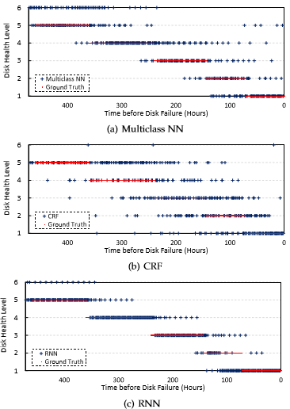
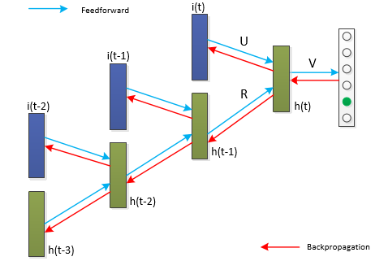
Model and Analysis
Notes:
We applied recurrent neural network to predict the health status of hard drives. Backpropagation through time is used for optimizing the model.
Compared with the time independent models such as Multiclass NN and short-range dependent models such as CRF, RNN can achieve better performance.
In the right figure, we can ﬁnd that RNN achieved higher prediction accuracy than the other two models. Besides, for the wrongly classiﬁed cases, the health degree prediction results of RNN are always clustered around the ground truth, while the wrongly predicted results of Multiclass NN and CRF are scattered.

Slide 21
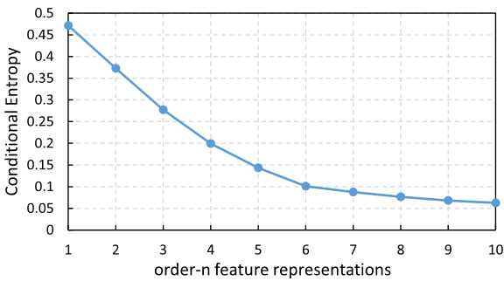
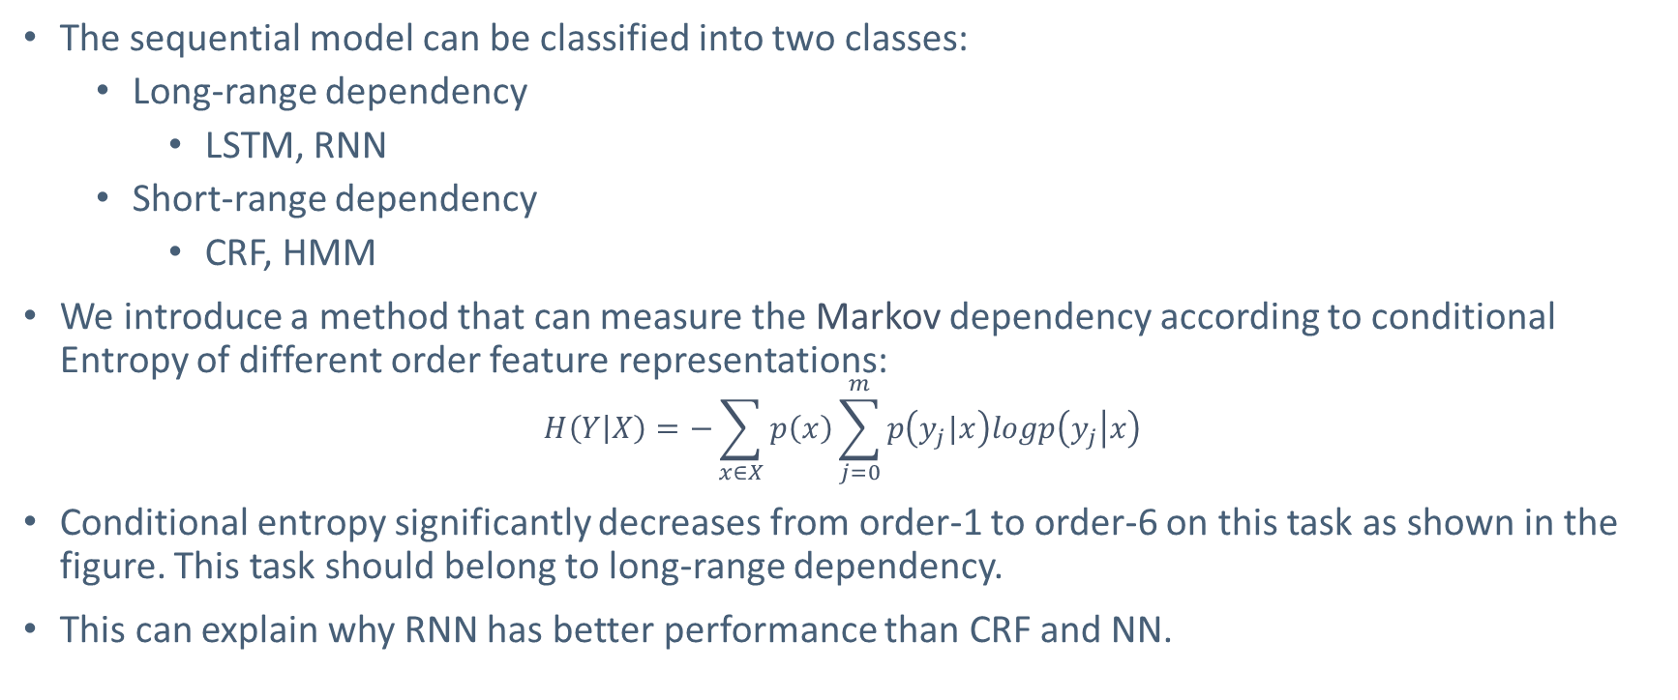
Dependency Analysis
The sequential model can be classified into two classes:
Long-range dependency
LSTM, RNN
Short-range dependency
CRF, HMM
We introduce a method that can measure the Markov dependency according to conditional Entropy of different order feature representations:
$$H\left(Y | X\right)=−\sum_{x∈X}{p\left(x\right)\sum_{j=0}^{m}{p\left(y_{j}|x\right)logp\left(y_{j} | x\right)}}$$
Conditional entropy significantly decreases from order-1 to order-6 on this task as shown in the figure. This task should belong to long-range dependency.
This can explain why RNN has better performance than CRF and NN.
Notes:
The time dependent tasks can be classified into two different categories. One is short-range dependent task, which can be solved by some traditional sequential model like CRF and HMM. The other is long-range dependent task, which is suitable for deep learning based models, like LSTM and Recurrent Neural Network.
Usually, the long-range dependency can be regarded as a kind of high-order Markov property – whether given some previous states, the current state is still highly correlated with those states even earlier. We can measured the Markov dependency by comparing the Conditional Entropy of different order feature representations.
We see that the conditional entropy significantly decreases from order-1 to order-6 as shown in the figure. Health Status Assessment for Hard Drives should belong to long-range dependency. This conclusion can also explain why RNN has better performance than short range dependent models such as CRF and sequential independent models such as NN.

Slide 22
Content
Previous Research Projects
Knowledge powered deep learning
Incorporating Knowledge into Word Representations
Sequential deep learning
Health Status Assessment for Hard Drives
Sequential Click Prediction for Sponsored Search
On-going Project
Deep Neural Network for Posed and Spontaneous Expression Recognition
Future Project
Deep Reinforcement Learning
Notes:
Then I will introduce my on-going project, which is Deep Neural Network for Posed and Spontaneous Expression Recognition.

Slide 23
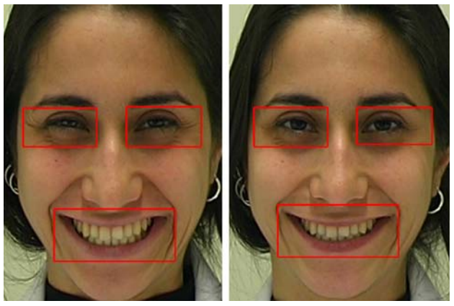
Posed and Spontaneous Expression Recognition
Posed and spontaneous expression recognition can be applied in many areas such as human-computer interaction, polygraph test, and medical diagnose
It is a more challenging task than conventional facial expression recognition.
Most of the previous works are based on Low-level features:
Tracking the dynamics of eyelid, cheek, and lip corner
movements based on landmarks.
Using discriminative completed LBP from three different
Orthogonal planes (eye, cheek and lip).
Spontaneous
Posed
Notes:
Diﬀerentiating posed expressions from spontaneous ones, which can be applied in many areas such as human-computer interaction, polygraph test, and medical diagnose, is a more challenging task than conventional facial expression recognition.
Although machine learning methods have been applied to the task, they suﬀer from some limitations. Firstly, most of the studies simply use the diﬀerence between onset and apex raw images as inputs, while the diﬀerence between the pixel-level images may not only contain noisy information, but also lose some useful information. Second, many works use hand-crafted features designed by rules, which suﬀer from inadequate capability of abstraction and representations

Slide 24
Deep Neural Network for Posed and Spontaneous Expression Recognition
The high-level image representations usually have less noisy information
I design a new kind of layer for deep convolutional neural network to represent the difference information between the onset (the early stages of an expression) and apex (the most intense stages of an expression) facial expression in middle and high abstraction levels.
It is still hard to model the expression dynamics by only using the apex and onset expression images
I plan to design a new framework to model the appearance, shape and dynamics of facial expression by using all information of videos together.
Notes:
Considering the high-level image representations usually have less noisy information, I design a new kind of layer for deep convolutional neural network to represent the difference information between the onset and apex facial expression in middle and high abstraction levels.
However, it is still hard to model the expression dynamics by only using the apex and onset expression images, I plan to design a new framework to model the appearance, shape and dynamics of facial expression by using all information of videos together. This project is still on going.

Slide 25
Content
Previous Research Projects
Knowledge powered deep learning
Incorporating Knowledge into Word Representations
Sequential deep learning
Health Status Assessment for Hard Drives
Sequential Click Prediction for Sponsored Search
On-going Project
Deep Neural Network for Posed and Spontaneous Expression Recognition
Future Project
Deep Reinforcement Learning
Notes:
My future research will focus on deep reinforcement learning.

Slide 26
Deep Reinforcement Learning
I plan to dive into deep reinforcement learning, a new promising area which have achieved great success recently in some AI tasks such as Atari Games and Go.
Current research topics about deep reinforcement learning include:
Addressing the exploration problem in large MDPs
Large-scale empirical evaluations
Improving existing value-function and policy search methods
Algorithms that work well with large (or continuous) action spaces
Efficient sample-based planning
Notes:
Reinforcement learning is an area of machine learning inspired by behaviorist psychology, concerned with how software agents ought to take actions in an environment so as to maximize some notion of cumulative reward. Current research topics about deep reinforcement learning include: addressing the exploration problem in large MDPs, large-scale empirical evaluations, improving existing value-function and policy search methods, algorithms that work well with large (or continuous) action spaces, efficient sample-based planning.
There is also a growing interest in real life applications of reinforcement learning. Therefore, I plan to work on deep reinforcement related topics in the future.

Slide 27
Conclusions
Research
Knowledge powered deep learning
Sequential deep learning
Representation learning
Deep reinforcement learning
Applications
Distributed word representations
Hard disk failure/health status prediction
Click prediction for sponsored search
Posed and spontaneous expression recognition
Notes:
In conclusion, I focus on several research areas. For example, Knowledge powered deep learning, the other is Sequential deep learning, Representation learning and deep reinforcement learning.
Some related applications includes Distributed word representations, Hard disk failure/health status prediction, Click prediction for sponsored search, and posed and spontaneous expression recognition and so on.

Slide 28
Thanks!

